Slide 1


Lecture 1
Produced by Dr. Worldwide
Welcome to the 305
~
~

Slide 2


Operations Research (OR)
Many different names ( Management Science, Business Analytics, etc.)
Discipline dealing with the application of advanced analytical methods to help make better decisions
Typically, there is a quantity that needs to be optimized
The objective function is a mathematical expression describing the quantity that we want to analyze in terms of key variables
Goal is to find best value of variables that either maximizes or minimizes the objective function

Slide 3
Models in OR
A model is a mathematical representation of a problem using mathematical relationships involving key variables, the objective function, and constraints
Two types of OR models
Deterministic models assume the relationships of a problem are fully known
Stochastic models allow some relationships to contain randomness
First part of course is focused on deterministic models

Slide 4
Ex: Production of Steel
Crysteel is a company that makes and sells steel products
Cost of $5 to produce one unit and each unit sells for $20
Each unit requires 4lbs. of steel and Crysteel has 100lbs. of steel
Q: How many units should be produced to maximize the profit?
Define variables
Z = Profit
x = Number of units to produce

Slide 5

Ex: Production of Steel
Profit is the difference between revenue and cost (Deterministic)
Company is limited on production due to finite amount of steel
The objective function with the constraint is our OR model
$$Z=\$20x−\$5x$$
Objective Function
$$4x≤100$$
Constraint

Slide 6





Ex: Production of Steel
Mathematical expression of OR model
We say that 20, 5, and 4 are model parameters
Remember we are trying to find the “best” value for x
Graphically, objective function is a straight line that always increases
Why not just make 100 units? Constraint
A: Set x=25 (Large as Possible) to maximize profit
$$Maximize Z=\$20x−\$5x$$
$$subject to 4x≤100$$
$$4x≤100$$
$$x≤25$$
$$Z=\$20×25−\$5×25=\$375$$

Slide 7

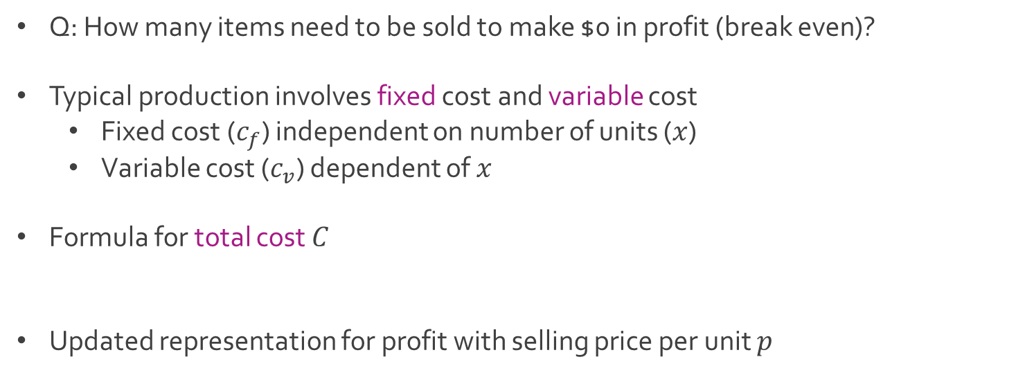
Break-Even Analysis
Q: How many items need to be sold to make $0 in profit (break even)?
Typical production involves fixed cost and variable cost
Fixed cost ($c_{f}$) independent on number of units ($x$)
Variable cost ($c_{v}$) dependent of $x$
Formula for total cost $C$
Updated representation for profit with selling price per unit $p$
$$C=c_{f}+c_{v}x$$
$$Z=px−\left(c_{f}+c_{v}x\right)=px−c_{f}−c_{v}x$$

Slide 8
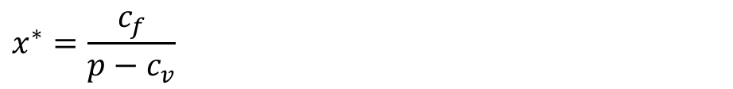
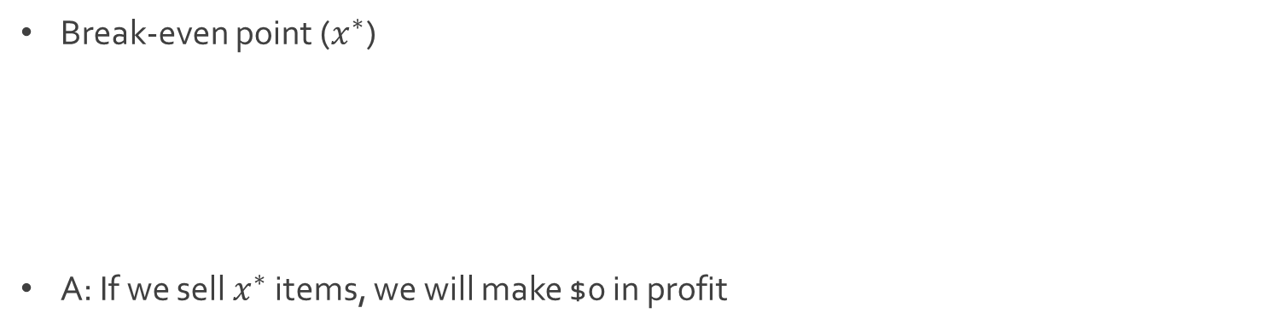
Break-Even Analysis
Break-even point ($x^{∗}$)
A: If we sell $x^{∗}$ items, we will make $0 in profit
$$0=px^{∗}−c_{f}−c_{v}x^{∗}$$
$$0=\left(p−c_{v}\right)x^{∗}−c_{f}$$
$$c_{f}=\left(p−c_{v}\right)x^{∗}$$
$$x^{∗}=\frac{c_{f}}{p−c_{v}}$$

Slide 9



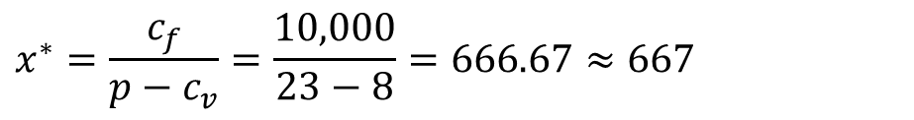

Ex: Production of Jeans
Jeanealogy creates dope jeans
They pay $10,000 to run their factory
Each pair of jeans costs $8 to make and sold at $23
Q: What is the break-even point in their production?
Key Variables
A: Break-even point
$$x=Number of Jeans Produced$$
$$c_{v}=\$8$$
$$c_{f}=\$10,000$$
$$p=\$23$$
$$x^{∗}=\frac{c_{f}}{p−c_{v}}=\frac{10,000}{23−8}=666.67≈667$$

Slide 10
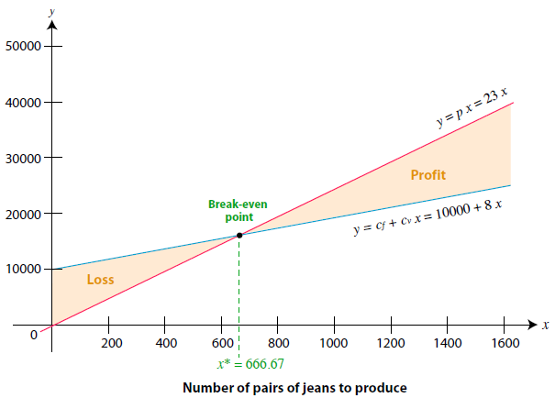
Ex: Production of Jeans
Finding the break-even point graphically

Slide 11
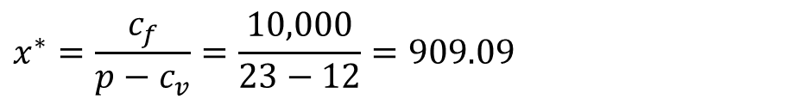
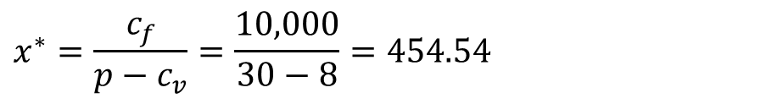
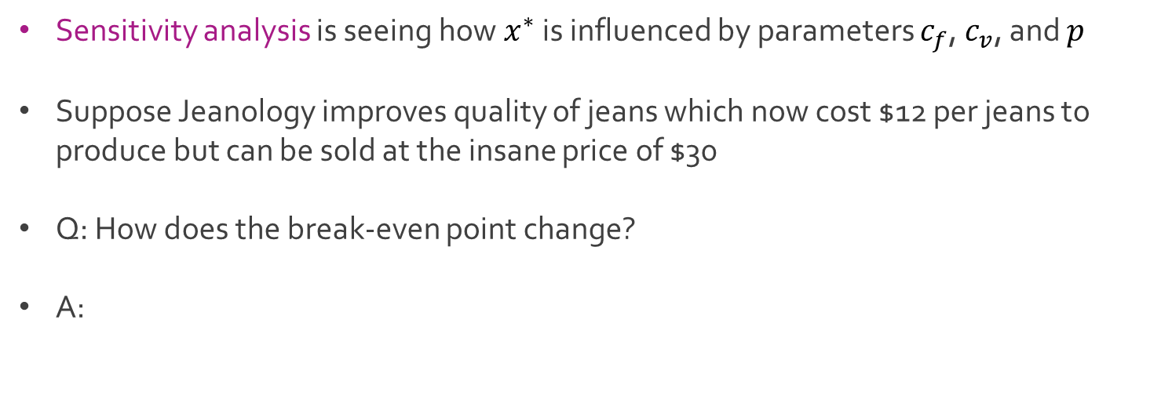
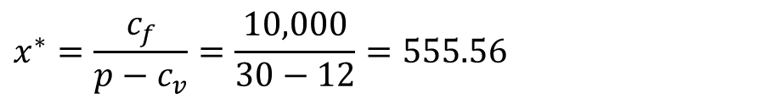
Ex: Production of Jeans
Sensitivity analysis is seeing how$x^{∗}$ is influenced by parameters $c_{f}$, $c_{v}$, and $p$
Suppose Jeanology improves quality of jeans which now cost $12 per jeans to produce but can be sold at the insane price of $30
Q: How does the break-even point change?
A:
$$x^{∗}=\frac{c_{f}}{p−c_{v}}=\frac{10,000}{30−8}=454.54$$
$$x^{∗}=\frac{c_{f}}{p−c_{v}}=\frac{10,000}{23−12}=909.09$$
$$x^{∗}=\frac{c_{f}}{p−c_{v}}=\frac{10,000}{30−12}=555.56$$

Slide 12
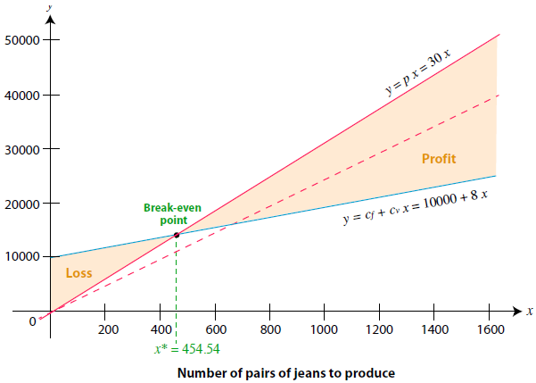
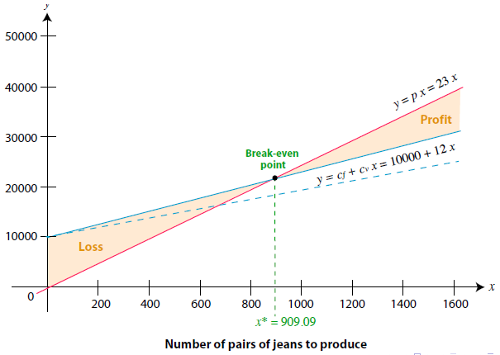
Ex: Production of Jeans
Graphical sensitivity analysis

Slide 13
Sensitivity Analysis Motivation
Business environment is dynamic, and parameters will change over time.
We need to see where small changes have big effects
Parameters are often estimated, and the break-even solution is inexact
Businesses want to know how reliable the solution is and what is the impact of deviations from expectation

Slide 14




The End
Dale

